Slide 1
The Battle of Neighborhoods | Finding a Better Place Angeles City, Pampanga, Philippines

Slide 2
Introduction
The purpose of this Capstone Project is to help people in exploring better facilities around their neighborhood.
Angeles City, Pampanga, where I stayed for 14 years, I was assigned in this neighborhood because of my work from previous company. The city is a 1st class highly urbanized city in the province of Pampanga, where it is geographically situated but remains politically independent. It is located in the region of Central Luzon, Philippines.
Due to new development in the region. Angeles City will be the main hub to Mega City in Central Luzon, with Clark International Airport under construction and is expected to be finished this year 2020.
Problem statement: Prospects of a Business establishment specially restaurant, close to office areas, and urban areas in Angeles City, Philippines.

Slide 3
Introduction
Target Audience
Business personnel who wants to invest or open a restaurant. This analysis will be a comprehensive guide to start or expand restaurants targeting the large pool of office workers in Angeles City and adjacent cities during lunch hours.
Freelancer who loves to have their own restaurant as a side business. This analysis will give an idea, how beneficial it is to open a restaurant and what are the pros and cons of this business.
New graduates, to find reasonable lunch/dinner place close to office.
Budding Data Scientists, who want to implement some of the most used Exploratory Data Analysis techniques to obtain necessary data, analyze it, and, finally be able to tell a story out of it.

Slide 4
Data Preparation
Get the barangay names, Population and Land Area of each barangay from city population and government website in the Philippines.
First make use of barangay population table of Angeles City page from City Population. I have used Pandas, Lxml and Beautifulsoup4 library to create the initial data-frame. And use same library for land area of each barangay from Philippines government website. For a clean and understandable data-frame, I renamed some of the barangay for data-frame merging. Using 10 barangay has commercial/business district, this will be use to get the most venues within 2 kilometers radius of each area later on.

Slide 5
Data Preparation
Get the coordinates of the major 10 barangay.
Some of the coordinates returned by Geopy library are wrong and some are missing using Nominatim and I have to correct using their barangay hall address and correct also the naming of each barangay and get the correct coordinates using Google API.

Slide 6
Data Preparation
Foursquare Data
Finally I make use of Foursquare API to obtain the most common venues within 2 kilometers of each 10 barangay.

Slide 7
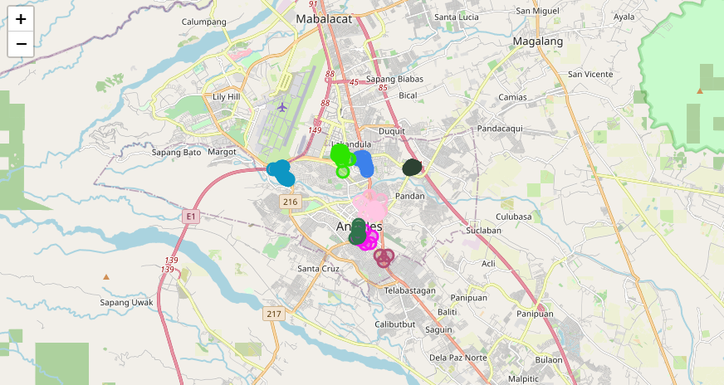
Exploring the Data and Major 10 barangay of Angeles City
From the Foursquare data, we could see that there are 84 unique categories, but for this analysis, We will concentrate in Restaurant Category. As the focus is on 10 Major Barangay in Angeles City,( Anunas, Balibago, Claro M. Recto, Lourdes Northwest, Malabanias, Pulung Maragul, Salapungan, San Nicolas, Santo Domingo, and Santo Rosario). We found that there are 147 restaurants among the 341 top venues in these 10 Barangay. I have used Folium library to plot a leaflet map of only these restaurants in these 10 Major Barangay of Angeles City. See map below.

Slide 8
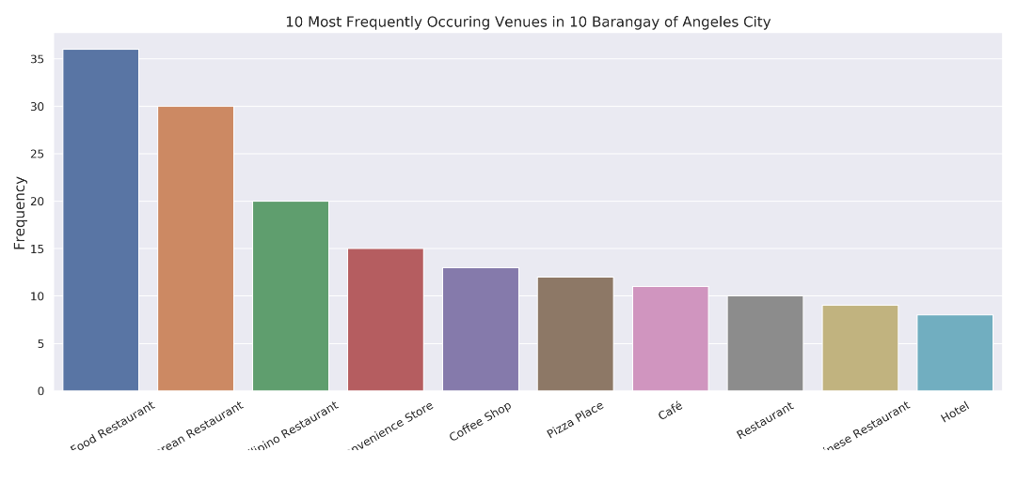
Exploring the Data and Major 10 barangay of Angeles City
Fast food restaurants top the charts of most common venues in the 10 Barangay, followed by Korean restaurants and Filipino restaurants
A plot of the 10 most frequent venues in these 10 Barangay.

Slide 9
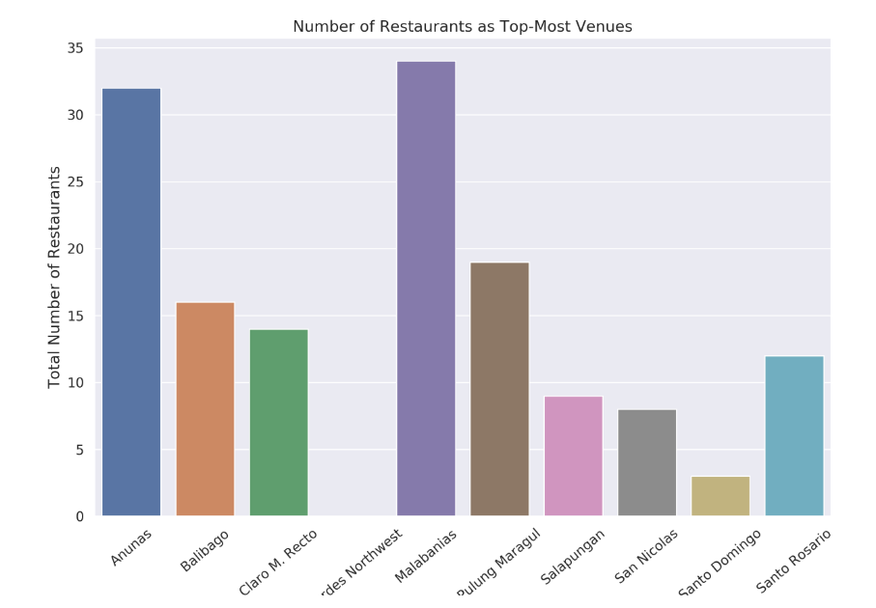
Exploring the Data and Major 10 barangay of Angeles City
And explore which barangay has the highest number of restaurants as the most common venue and the plot below.

Slide 10
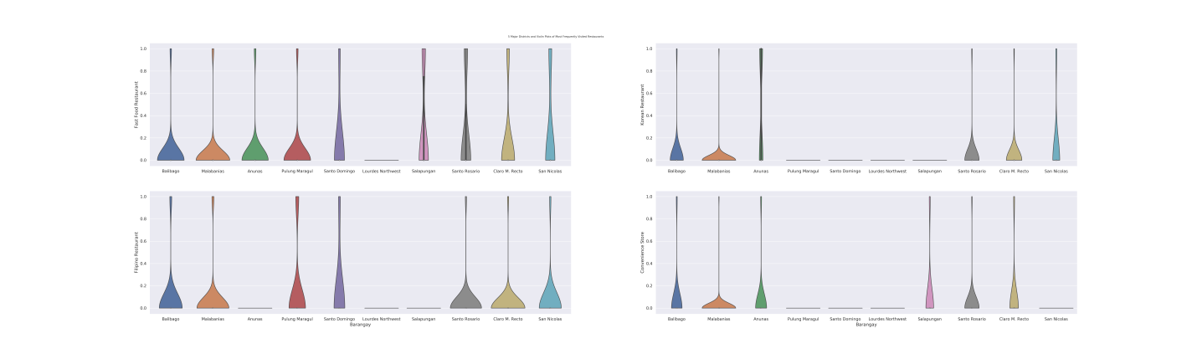
Exploring the Data and Major 10 barangay of Angeles City
Since the focus is mostly on the competitions provided by restaurants on these barangay, I also explored how most common restaurant categories are distributed in each barangay and the violin plot below of categorical variables give the answer.

Slide 11
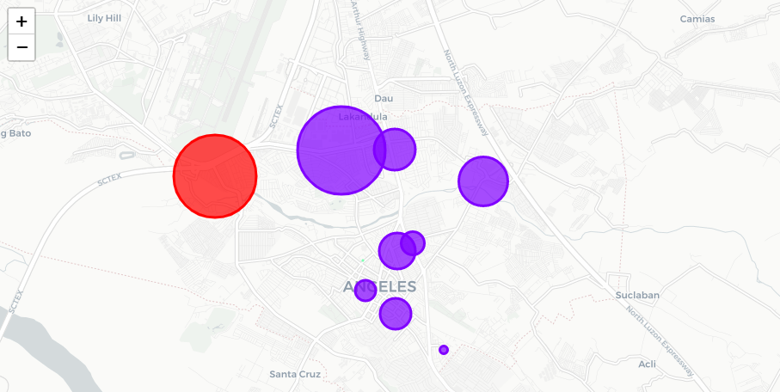
Exploring the Data and Major 10 barangay of Angeles City
We try to cluster these 10 barangay based on the frequency of venue categories and use K-Means clustering. Our expectation would be based on the similarities of venue categories, these barangay will be clustered. Using K-Means algorithm from Scikit-learn librady we obtain 3 clusters as shown below.

Slide 12
Exploring the Data and Major 10 barangay of Angeles City
Here the radius of the circles represent the number of restaurants as most common venue for the corresponding barangay and, we have seen that it is maximum for Barangay Malabanias (34) followed by Anunas (32) and no restaurant in Barangay Lourdes Northwest.
For the most common venues this clustering makes a complete sense as most of the barangay are dominated by Fast Food restaurant, Filipino restaurant, Chinese restaurant falss under the purple cluster whereas barangay Anunas dominated by Korean restaurant and Convenience store falls under red cluster. And Lourdes Northwest with light blue cluster dominated with Market and Café.

Slide 13
Results
Fast food restaurants top the charts of most common venues in 10 Major barangay.
Barangay Anunas are dominated by Korean restaurants and convenience store. Don’t have any Filipino restaurant nearby.
Lourdes Northwest don’t have any restaurant but have market and café.
Barangay Malabanias and Pulung Maragul dominated with restaurants because near Commercial Malls like SM Malls and Ayala Malls.
The clustering was based only on the most common venues on each barangay. Most of the group with Filipino and Fast food restaurant are clustered, second is Korean restaurant and convenience store are clustered and the last one with no restaurant but café and market.

Slide 14
Discussion
According to the analysis, Barangay Lourdes Northwest will provide least competition for an upcoming lunch restaurant as no restaurant nearby, only market and café.
From web-scrapped data, Barangay Santo Domingo, could potentially be a target for starting quality restaurants as its near the border of Angeles City and common venue is café also.
Some drawbacks of this analysis are – we don’t have any data for the average land price and the clustering is completely based on the most common venues obtained from Foursquare data. Since the distance of the venues from any public utility vehicles, number of potential customers, benefits and drawbacks of Barangay Lourdes Northwest , could all play a major role and thus, this analysis is definitely far from being conclusory. However, it gives us preliminary information on possibilities of opening restaurants around the 10 Major barangay in Angeles City.
If we have other data that will help with our analysis and adding other clustering techniques the result could vary.

Slide 15
Conclusion
We have got a small glimpse of how to real life data –science projects look like. Using some frequent python libraries we get the data using scrap web-data, use Foursquare API to explore the 10 major barangay in Angeles City, and use Google API for the geolocation of each barangay. We saw the results of segmentation of barangay using folium leaflet map. Some of drawbacks and chance for improvements to represent even more analysis in real life business problem. Since the analysis were mostly concentrated on the possibilities of opening a restaurants. Some of the results obtained are surprisingly what I have expected after 14 years of staying in Angeles City.

